Slide 1



NLP Toolkit Web App: An AI Enthusiast's Project
Hello! I'm Anam Jafar, an AI enthusiast deeply immersed in Natural Language Processing. This project showcases a practical application of my studies, built with Python and Streamlit.
by Anam Jafar

Slide 2
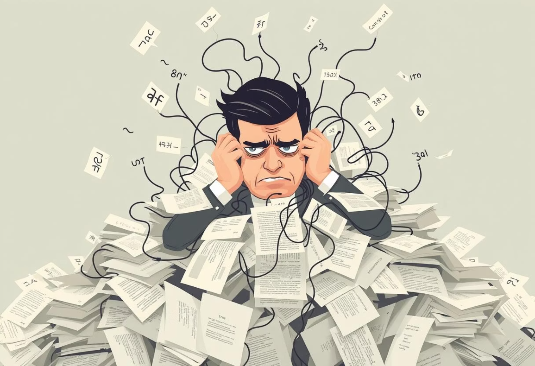
The Challenge: Navigating Text Complexity
Manual text analysis is time-consuming and prone to errors. Large datasets and language barriers complicate insights. Complex NLP tools often intimidate beginners, creating a steep learning curve.
Time-Consuming
Manual analysis is slow and inefficient.
Error-Prone
Human errors in large datasets.
Complex Tools
High barrier to entry for beginners.

Slide 3
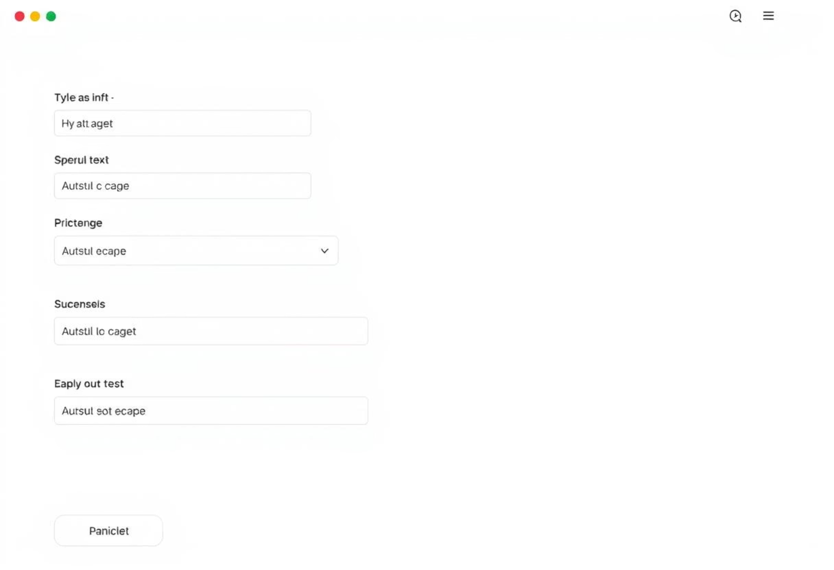
Introducing the NLP Toolkit Web App
The NLP Toolkit Web App offers an intuitive solution for diverse text tasks. It provides capabilities for processing, cleaning, and translating text directly via a web browser, requiring no coding experience.
User-Friendly Interface
Accessible for all skill levels.
Versatile Capabilities
Text processing, cleaning, translation, and more.
Browser-Based
No software installation needed.

Slide 4





Powered by Leading AI Libraries
The app leverages robust libraries to deliver powerful NLP functionalities.
Streamlit
For the interactive web interface.
spaCy & NLTK
Core text processing and analysis.
TextBlob
Simplified text processing.
Sumy & Deep Translator
For text summarization and multi-language translation.
scikit-learn
Enabling robust news article classification.

Slide 5
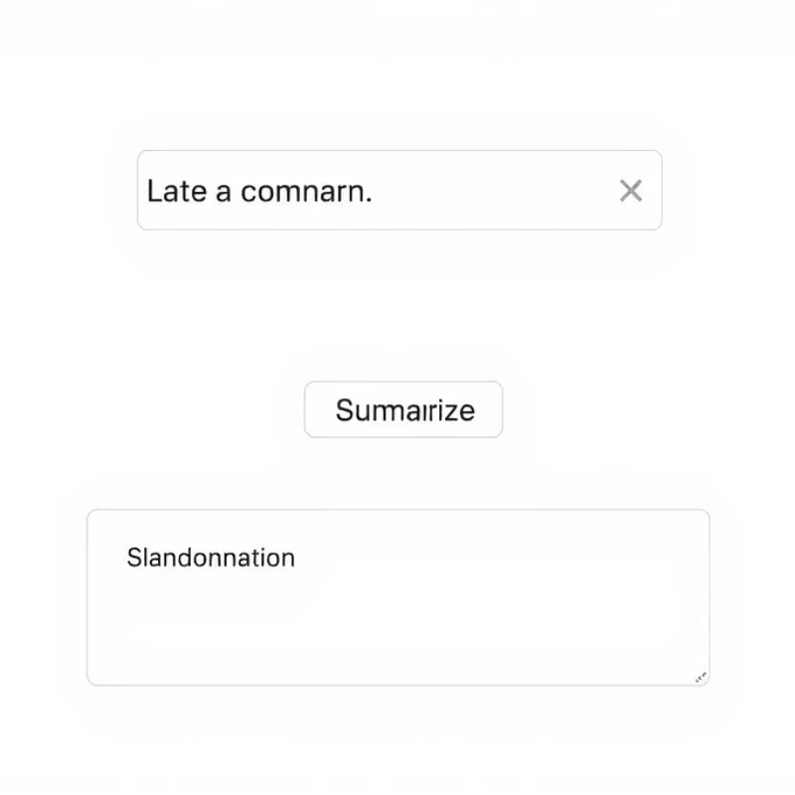
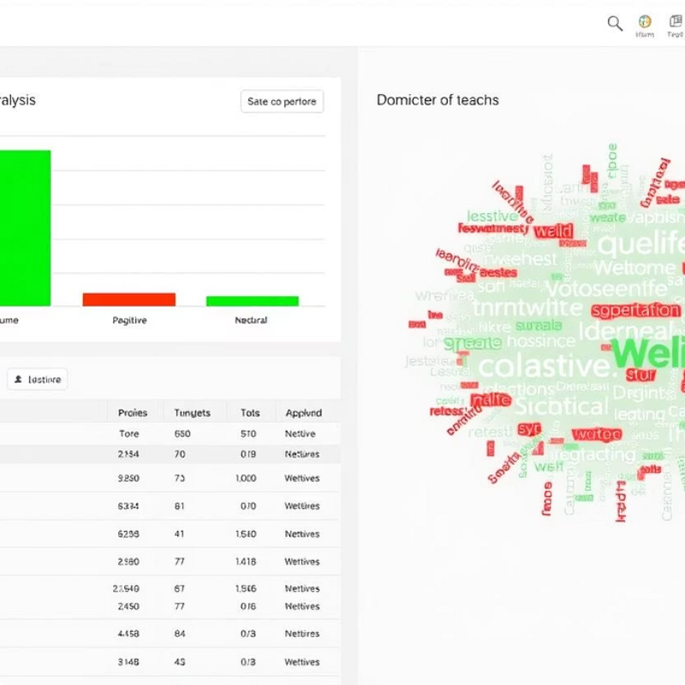
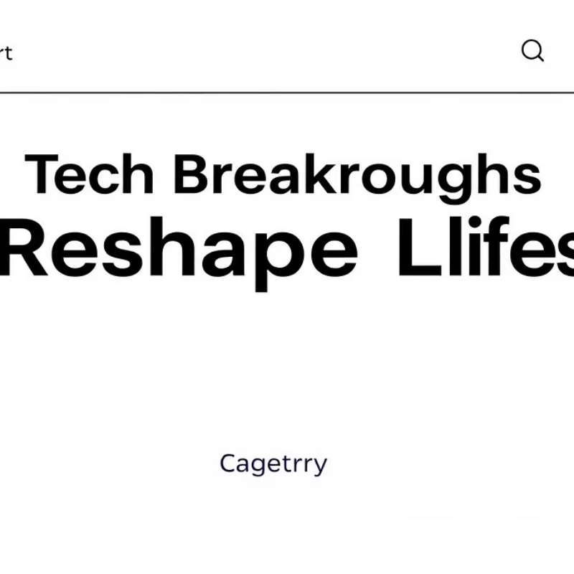
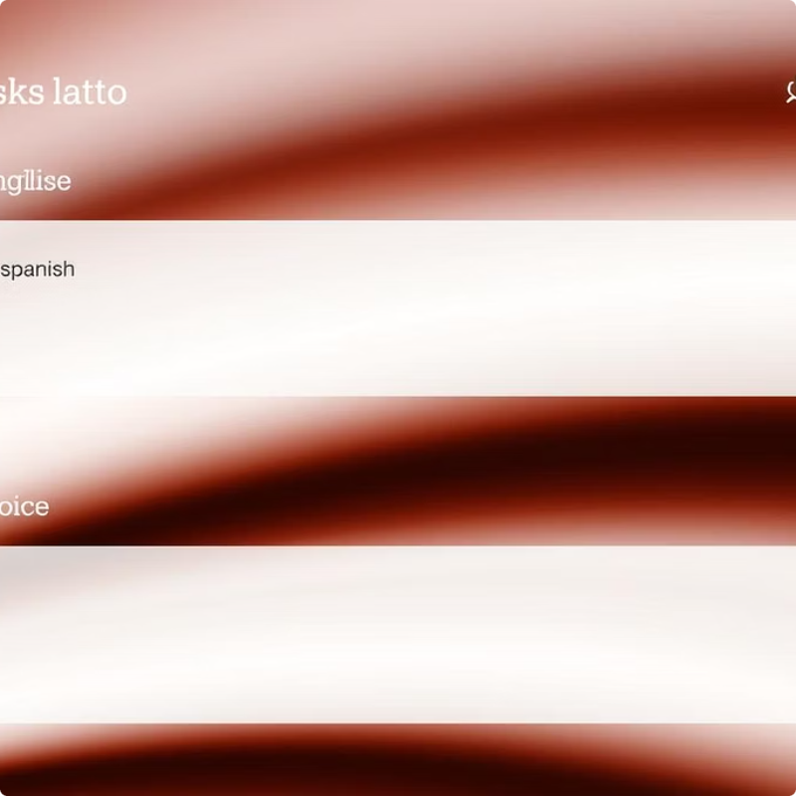
Key Features in Action
Explore the core functionalities that streamline your text analysis tasks.
Text Cleaning & Summarization
Sentiment Analysis & WordCloud
News Article Classification
Text & Voice Translation
Quickly refine and condense large texts.
Visualize emotions and key themes in your text.
Automatically categorize articles with precision.
Seamlessly translate between multiple languages.

Slide 6
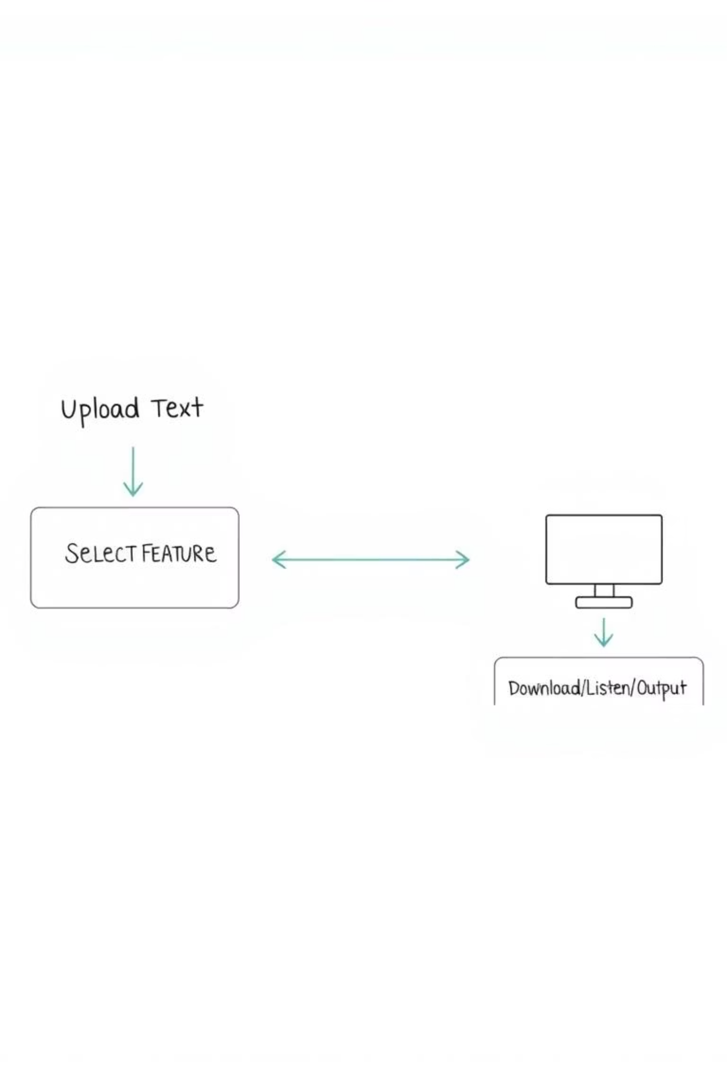




Intuitive Workflow
The app's design ensures a smooth and straightforward user experience.
1. Input Text
Upload a file or type directly.
2. Select Feature
Choose desired function from sidebar.
3. Process & Display
App processes and shows results instantly.
4. Output & Export
Download text or listen to audio.

Slide 7
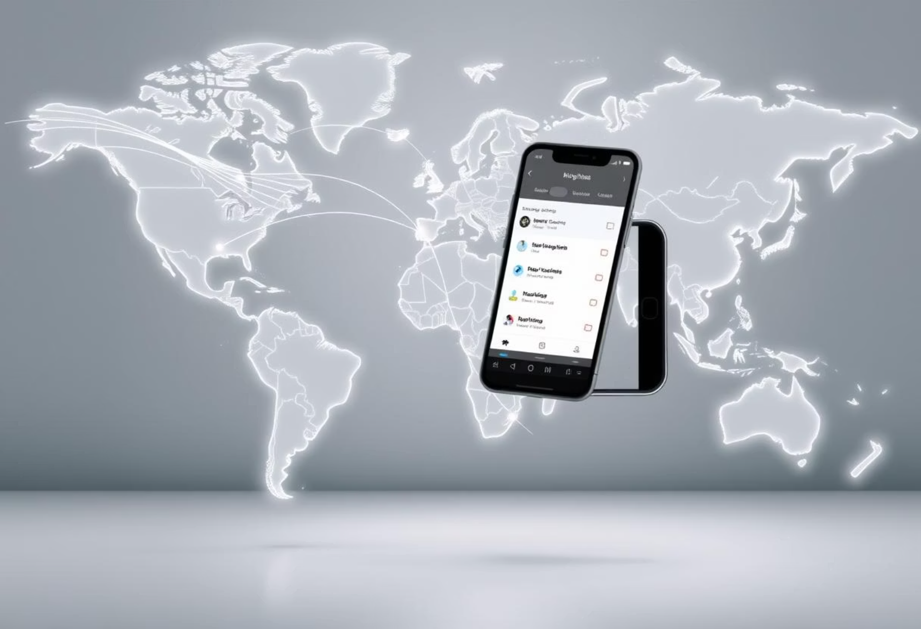
Future Vision: Expansion & Innovation
While currently focusing on English, future iterations will significantly expand language support and introduce a dedicated mobile application.
Enhanced Language Support
Expand beyond primary English support to a wider array of global languages.
Mobile Application Development
Bring the NLP Toolkit to iOS and Android platforms for on-the-go access.
Advanced NLP Features
Integrate more sophisticated text analysis capabilities.

Slide 8



Thank You!
Thank you for your time and attention to the NLP Toolkit Web App. Your feedback and questions are highly welcome!

